Slide 1
Evolving the Idaho Behavioral Health Plan and Care Delivery System
May 2018

Slide 2
Vision & Strategy
Vision
To further develop an integrated, community-based, and outcomes-driven system of care that supports and promotes each Member’s recovery and resiliency journey
Strategy
To improve a Member’s Behavioral Health Outcomes

Slide 3
Youth Empowerment Services (YES) System of Care: Philosophy
Building a system of care means changes in:
The values and principles that guide our practices
Our assumptions and biases about those we serve
The way systems are designed and collaborate in the interest of children, youth and families
The way we deliver services
Building a system of care relies on the coordinated delivery of services

Slide 4
YES System of Care: Core Values
The 3 Core Values that Guide Developing and Implementing a System of Care:
3.
2.
1.
1. Family Driven and Youth Guided With the strengths and needs of the child and family informing the types and mix of services and supports provided.
3. Culturally & Linguistically Responsive With agencies, programs, and services that reflect the cultural, racial, ethnic, and linguistic differences of the populations they serve to facilitate access to and utilization of appropriate services and supports and to eliminate disparities in care.
2. Community Based With the focus of services as well as system management resting within a supportive, adaptive infrastructure of structures, processes, and relationships at the community level.

Slide 5
YES System of Care: Characteristics
A Well-Functioning System of Care Utilizes:
Collaboration across agencies
Partnership with youth & families
Cultural & linguistic responsiveness
Shared governance across systems & with youth & families
Shared outcomes across systems
Organized pathway to services & supports
Interagency/youth & family services planning teams
Interagency/youth & family services monitoring teams
Single plan of care

Slide 6
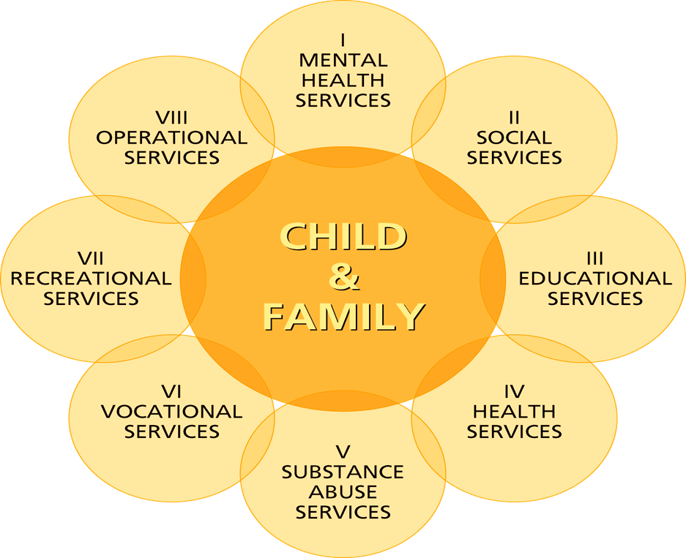
YES System of Care: Child and Family Team Framework
Stroul, B., & Friedman, R. (1986). A system of care for children and youth with severe emotional disturbances (Rev. ed.) Washington, DC: Georgetown University Child Development Center, National Technical Assistance Center for Children’s Mental Health. Reprinted by permission.

Slide 7
Skills Building/CBRS:
Overview

Slide 8
Learning Outcomes
Participants will:
Get clarification and clear examples on the definition, use and benefits of Skills Building for child, adolescent and adult Members
Learn how Skills Building can be used in a Teaming Approach between Master’s level clinician and paraprofessional to develop an individualized treatment plan
Gain knowledge on the Level of Care Guidelines (LOCGs), Service Request Forms and payment methodology
Be informed about how to access Skills Building resources using Optum’s Educational Platform

Slide 9
Skills Building Goal
To create an educational platform that includes resources and trainings on Skills Building interventions that are “Needs and Strengths Driven” and “Education Supported”.

Slide 10
Evidence-Based Practice (EBP) Resource Library
Optum Idaho has developed a resource list of evidence-based practices (EBPs) to promote the use of scientifically established behavioral health interventions.
The recommendations for external EBP resources are based on research done through SAMHSA’s National Registry of Evidence-Based Programs and Practices (NREPP) and other EBP Clearinghouses
Include identified target area (diagnosis or specialty population), cost, and delivery of each resource.
Located under Network Providers tab on July 1, 2018

Slide 11
Key Components and Benefits of Skills Building
Functional Assessment Tool (ex: CANS)
Identifies strengths and needs
Provides linkage between needs and treatments
Facilitates communication across the system
Allows for the development of a more robust individualized treatment plan
Allows outcomes measured over time
Clinician and Paraprofessional Team
Promotes collaboration and teaming between formal and informal supports
Treatment plan is developed using “Teaming Approach”
Utilizes evidence-based skills building interventions

Slide 12
Psychiatric Rehabilitation Association (PRA)
Dori S. Hutchinson, Sc.D., CPRP, CFRP will present here

Slide 13
Skills Building/CBRS Professional Requirements
Certified Psychiatric Rehabilitation Practitioner (CPRP) certification
Child and Family Resiliency Practitioner (CFRP) certification
Optum to provide CEU opportunities
Complete CPRP and/or CFRP certification
Roster to be maintained of Skills Building/CBRS professionals eligible to provide services (effective July 1st)

Slide 14
What’s Different on July 1st, 2018?
Teaming approach encouraged via new billing codes
Further clarification in Level of Care Guidelines
Streamline documentation for Service Request Form (SRF) to include treatment plan
Training on Skills Building interventions available to network Providers and funded by Optum

Slide 15
Step 1: Comprehensive Diagnostic Assessment (CDA) Overview – Children/Adolescents
Completed by an independently licensed clinician
Elements include: presenting problem, behavioral health treatment, medical, family and developmental history, complete DSM diagnosis, mental status exam, risk assessment, substance abuse screening, spiritual and cultural needs, medication information, recommendations
Admission Criteria as indicated on Skills Building LOCGs:
Serious Emotional Disturbance (SED)
Difficulty gaining and utilizing skills necessary to function adaptively in home and community settings
Impact at least one (1) of the following areas, continuously or intermittently:
Vocational/Educational
Social relationships/support
Family
Basic Living Skills
Community/Legal

Slide 16
Step 1: Comprehensive Diagnostic Assessment (CDA) Overview - Adults
Completed by an independently licensed clinician
Elements include: presenting problem, behavioral health treatment, medical, family and developmental history, complete DSM diagnosis, mental status exam, risk assessment, substance abuse screening, spiritual and cultural needs, medication information, recommendations
Admission Criteria as indicated on Skills Building LOCGs:
Severe and Persistent Mental Illness(SPMI)/Serious Mental Illness(SMI)
Difficulty gaining and utilizing skills necessary to function adaptively in home and community settings
Impact at least two (2) of the following areas, continuously or intermittently:
Vocational/Educational
Social relationships/support
Family
Health/Medical
Basic Living Skills
Community/Legal
Financial
Housing

Slide 17
How to Guide: Level of Care Guidelines (LOCGs)
Use of CDA with functional assessment measurement tool
Teaming approach
Individualized skills building treatment plan developed to address identified functional needs

Slide 18
Step 3: Treatment Planning with Skills Building “Teaming Approach”
Clinician focuses on
MOOD, BEHAVIOR, THINKING SKILLS
*Comprehensive Diagnostic Assessment
*Functional Needs Assessment
Paraprofessional focuses on
FUNCTIONAL SKILLS
SKILLS BUILDING
Treatment Plan

Slide 19
Examples of Skills Building
Covered activities include:
Emotional skills, such as coping with stress, anger, or anxiety
Behavioral skills, such as positive peer interactions, appropriate family and social interactions
Managing overt expression of symptoms like impulsivity and anger
Daily living and self-care skills, such as personal care and hygiene
Daily schedule, structure and use of time
Cognitive skills, such as problem solving, developing a positive self-esteem, and reframing
Money management
Community integration skills
Understanding illness, symptoms, and the proper use of medications
Any similar skills needed to implement a Member’s treatment plan

Slide 20
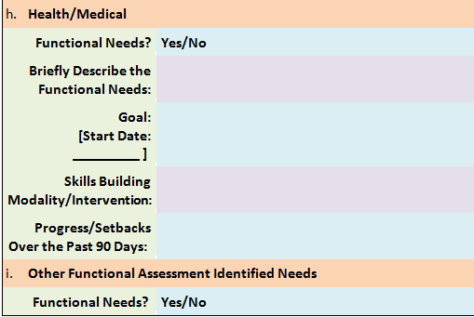
How To Guide: Requesting Skills Building

Slide 21
How To Guide: Billing Codes for Skills Building
Code | New or Existing? | Description | How Managed?
H2017 | Existing, but Increased Rate for Paraprofessionals | Skills Building/CBRS | Prior Authorization
H0032 | Existing, but New Rate & Modifiers | Billed by Clinician & Paraprofessional for Teaming When Developing the Individualized BH Treatment Plan | Threshold Management

Slide 22
How it Will Work:
From a Youth’s Perspective

Slide 23
Joey’s Assessment
Diagnosed with a Severe Emotional Disturbance
Witnessed family violence and has a history of abuse and neglect
Problems interacting with others and building and maintaining relationships
Experiences behavioral outbursts in school including yelling, screaming, being disrespectful and interrupting class
Anxiety symptoms and tends to isolate
Difficulties feeling connected to others
On probation for assaulting a peer at school

Slide 24
Joey’s Team
The process starts with a Child and Family Team that develops the child’s overall plan:
Person Centered Plan (not all Members will have a PCP)
Individualized Treatment Plan
Some youth may also have Wraparound Plan
The plan is driven by the needs and desires of Joey and his family
Joey and his family identified that his teacher, therapist, medication provider, probation officer, resource officer at school would be members of his team
Team identified that Joey needs Skills Building

Slide 25
Skills Building Training Disruptive Behavior Disorder
Skills Building training for both paraprofessionals and mental health clinicians on how to team together to support children and adolescents with disruptive behaviors and their families
Skills Building for Disruptive Behavior Disorder will include six (6) hour webinar series (six CEU’s) and e-learning modules:
Foundational Psychoeducation:
Understanding and Assessment
Clinical Intervention Education:
Teaching Provider Skills to Teach Child and Adolescents
Teaching Provider Skills to Teach Parents
Child and Parent Support Videos and Tools
Skills Building education and tools will also be available for schools, and informal community support sources that help support the family

Slide 26
Outcomes of Joey’s Skills Building Treatment Plan
Joey can identify his emotional triggers and when he needs to use STOP THINK ACT intervention
Decreased behavioral anger outbursts in class
He was able to comply with his probation requirements

Slide 27
Next Steps:
Skills Building Timeline

Slide 28
Next Steps
Continue streamlining documentation and training on the Level of Care Guidelines (LOCG), Service Request Form (SRF) and billing codes for Skills Building/CBRS
Continue to roll out Skills Building training which specifically target diagnostic groups and/or functional needs and deficits
Begin to incorporate CANS data for more meaningful measurement of outcomes
Further align with Psychiatric Rehabilitation Association (PRA) credentialing criteria

Slide 29
Questions?
Please send any questions not answered during the presentation to:
optum.idaho.yes@optum.com

Slide 30
Additional Information
Please check optumidaho.com > For Network Providers for revisions to:
Provider Manual (July 1st)
Level of Care Guidelines (posted 6/1; effective 7/1)
Service Request Forms (mock posted 6/1; effective 7/1)
YES Principles of Care and Practice Model are currently located here:
youthempowermentservices.idaho.gov > About YES > Communications > YES Principles of Care & Practice Model

Slide 31
Thank you

