Slide 1
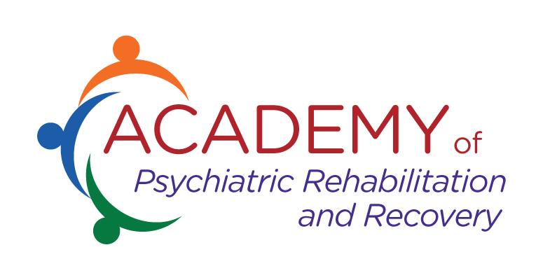
Children’s Skills Building/CBRS
An Optum Partnership with
Psychiatric Rehabilitation Association
Dori Hutchinson, Sc.D, CPRP, CFRP
Director of Services, The Center for Psychiatric Rehabilitation-Boston University
Chair, Psychiatric Rehabilitation Foundation of PRA
© 2017-2021, Psychiatric Rehabilitation Foundation. All rights reserved.

Slide 2
Psychiatric Rehabilitation Association
Founded in 1975; Members are from the United States and 11 different Countries. It is both an association (501(c)(6) and a foundation (501 (c)(6).
The diverse membership of PRA includes agencies, eclectic practitioners, families and persons living with psychiatric disabilities, leaders in psychiatric rehabilitation education and research from major universities across the United States and the world.
State and federal government entities dedicated to improving outcomes in a cost-effective, evidenced-based and highly successful model also are affiliated with PRA including New York, California and SAMHSA and NIDILRR support the 4 National Research and Training Centers in Psychiatric Rehabilitation.

Slide 3
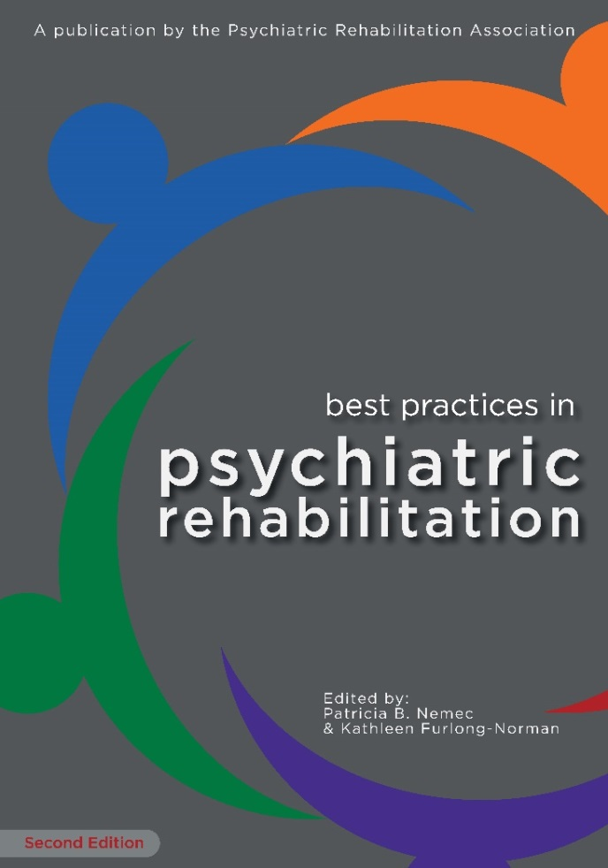
Our Mission
We advocate for ethical and effective resiliency, wellness and recovery oriented services and supports.
We provide education and training to improve the qualifications of our behavioral healthcare workforce through the highest standards of certification and professional education to ensure that children and adults with behavioral health conditions thrive in their roles and communities as full citizens.

Slide 4
What is Psychiatric Rehabilitation?
Psychiatric rehabilitation as a FIELD promotes recovery, full community integration, and improved quality of life for individuals across the lifespan who have been diagnosed with any mental health condition that seriously impairs their ability to lead meaningful lives.
Psychiatric rehabilitation SERVICES are collaborative, person-directed and individualized. They recognize the EXPERTISE of the person in need of services.
Providers focus on helping individuals develop skills and access resources needed to increase their capacity to be successful and satisfied in the living, working, learning, and social environments of their choice.

Slide 5
What is Psychiatric Rehabilitation? Cont.
People with eclectic backgrounds can deliver psychiatric rehabilitation services. It is not specific to 1 profession.
BUT, it does require ethics, knowledge and skills on how to assist individuals to set rehabilitation goals, assess functioning in relationship to that goal, teach skills related to the goal and develop resources.
It focuses on helping individuals FUNCTION in their daily lives-their ROLES and their ENVIRONMENTS.
Views symptoms, problems and challenges as obstacles to the goal, their elimination is NOT the primary goal.

Slide 6
Certification by Psychiatric Rehabilitation Association
Fosters the growth and development of a qualified, ethical and culturally diverse workforce
Provides avenues for psych rehab practitioners from a wide variety of educational backgrounds to become certified
Unique in Mental Health. CFRP & CPRP are only credentials available to practitioners with or without post-secondary credential

Slide 7
Benefits of Certification
Meets employer or governmental requirements
Increases and/or validates skills and knowledge
Potential for increased opportunities for career advancement and/or increased earnings
Demonstrates a certain level of knowledge and skill
Demonstrates a high level of commitment to the field of practice
Supports continued professional development
Enhances feelings of personal accomplishment and satisfaction
Enhances professional credibility
Recognition by a third party such as OPTUM

Slide 8
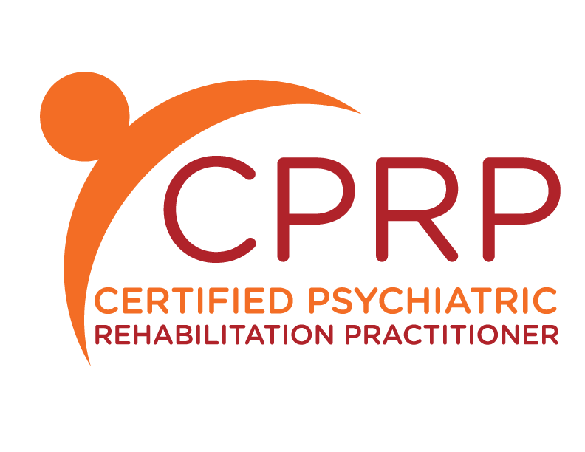
Certified Psychiatric Rehabilitation Practitioner…
CPRP is a test-based certification (2001) that fosters the growth of a qualified, ethical, and culturally diverse psychiatric rehabilitation workforce through enforcement of a practitioner code of ethics.
Currently there are CPRPs with PhDs to GEDs, occupational therapists to peer specialists, social workers to caseworkers all of whom share a commitment to the fundamental principle that recovery from serious mental illness is possible.
8 domains of Practice
CPRP’s deliver a range of best practices, promising practices and evidenced based practices to help adults live, learn, work, in the roles of their choice and the communities of their choice.
CPRP’s focus on assisting the person develop the critical skills and supports they need to thrive, not just survive, at home, in their relationships, in school/training, at work and in their communities.

Slide 9
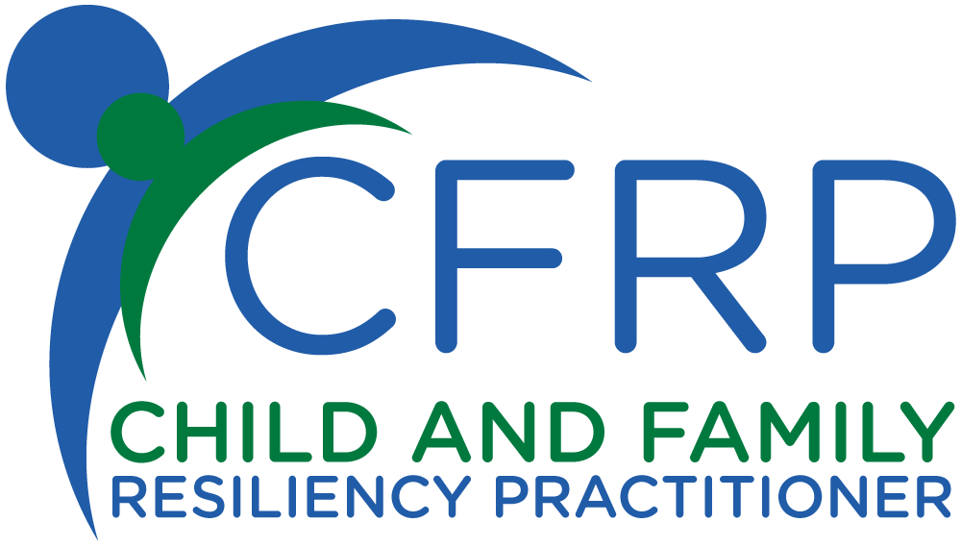
Certified Child and Family Resiliency Practitioner…
is a test-based credential (2016) that moved from certification (2010), that fosters the growth of a qualified, ethical, and culturally diverse child and family psychiatric rehabilitation workforce through enforcement of a practitioner code of ethics.
CFRPS may be individuals with PhDs to GEDs, occupational therapists to teachers, social workers to caseworkers, all of whom share a commitment to the fundamental principle that children are resilient.
8 domains of practice
CFRP’s promote quality of life, community integration and successful transition to adulthood through skill and resource development for children and youth who have experienced serious emotional or behavioral difficulties that significantly impair their ability to function successfully in home, school, family or community life.
Notes:
Certification states you were trained but doesn’t demonstrate you actually have the knowledge and skills. Credential tests your knowledge and skills to demonstrate you are qualified.

Slide 10
The Child and Family Team Approach
A process that brings together the child, their family and all the individuals they believe can help them in achieving their goals.
These individuals are not only TREATMENT providers, but can be informal community based supports- relatives, neighbors, coaches, faith-based connections, and teachers.
The Team can be small or large depending upon the needs of the member.
Child and Family Driven.

Slide 11
The Benefits of The Teaming Approach
It meets our professional, ethical obligations of promoting resiliency & recovery through:
A strengths- based approach that promotes hope, respect, choices and the positive expectation that individuals and families WILL SUCCEED.
The Voice and Choice of the member and their family is defined as including their expertise, and promoting their empowerment and self-determination.
Recognition of the critical importance of the family strengths, needs & culture in resilience and recovery.
Recognition of the importance of natural support systems in the member and family’s community. This includes both informal and formal services, supports and programs.
Partnership and collaborative team-based decision making with the member and family to achieve the individual’s goals.

Slide 12
The Benefits of The Teaming Approach Cont.
The teaming approach works as it:
Taps into a wider pathways of provider services and supports across agencies that promote wellness and resilience in the member and their family.
The member and their family experience improved quality of care and better OUTCOMES-they achieve their goals of thriving and functioning more successfully.
Has research evidence that demonstrates team functioning is associated with better outcomes, cost savings, reduced hospitalization , improved service provision, and enhanced member and provider satisfaction.
It promotes shared governance and outcomes as responsibility is shared with the family, the member and those on the team. This is done through collaborative planning, service delivery, problem-solving and monitoring.

Slide 13
The Teaming Approach and the 8 Domains of CFRP
Interpersonal competencies
Professional Role
Community Integration
Assessment, Planning & Outcomes
Strategies for facilitating Resiliency and Recovery
System competencies
Supporting Health and Wellness
Transition Aged Youth Services

Slide 14
Practitioner Skills for the Team
Interpersonal Competencies-The essential skills a team member needs to engage, respond, partner, collaborate, teach, support and motivate a member and their family towards their goals.
Professional Role-Teaches the critical ethics that guide a team member in effectively helping a member and their family.
Community Integration-Focuses on skills of developing linkages, networking, maximizing natural supports and advocating for member and family.
Assessment, Planning and Outcomes-Focus is on skills of identifying holistic needs, strengths, interests, barriers while respecting development, culture and family perspectives. Creating and modifying rehabilitation plans to support outcomes.

Slide 15
Practitioner Skills for the Team, Cont.
Strategies for Facilitating Resiliency and Recovery-A focus on acquiring knowledge of and utilize various skills based approaches to engage children and families including evidence based practices, best practices and culturally relevant practices. Teaching Skills for utilization in roles and environments.
System Competencies-A focus on knowledge and skills of cross collaboration of systems of care, advocacy for rights of the member and family, and the encouragement, development and use of peer to peer and family peer support services.
Supporting Health and Wellness- A focus on teaching children and Families to identify and use strategies and community resources for improving their 8 dimensions of wellness. Understanding the impact of trauma and it’s relationship to wellness across the lifespan.
Serving Transition Aged Youth- Understand and recognize different developmental norms of youth and the skills needed to engage, teach and support youth

