Slide 1
Medical Necessity and System Transformation in Idaho
Changes in Behavioral Health under Medicaid
Jeffrey Berlant, M.D., Ph.D.
Medical Director and Chief Medical Officer, Optum Idaho
Presented by:
Dennis J. Woody, Ph.D.,
Clinical Director, Optum Idaho

Slide 2
Overview
Identifying Idaho’s Issues
Optum Benefit Structure
Medical Necessity Review
Pre-Optum PSR Utilization Stats
Case Studies
Directions for System Transformation
Summary

Slide 3
Nation Wide Changes and Idaho
Medical and mental health care: wide-spread trends towards measured outcomes, optimized practices, and use of standardized practices
Some services provided in Idaho vary substantially from other states in the nation
Some have questioned whether Idaho residents under Medicaid are receiving the right care

Slide 4
Optum Idaho’s Benefit Structure
The benefit has changed!
Prior Medicaid program: capped limit to number of therapy visits per year whatever the type of therapy
Optum Idaho benefit expands coverage for more medically necessary psychotherapy services, concurrent types of therapies, and allows for multiple-provider team involvement

Slide 5
Optum Idaho Benefit Structure
Clinical Service | Optum benefit
Caps | No (use med necessity)
Individual therapy | Once or more per week
Extended-length sessions | Yes with PA
Family therapy +/- Member | Yes
Group therapy | Yes
Home-based therapy visits | Yes (new)
Crisis intervention | Yes
Telepsychiatry (MD & PNP) | Yes
CBRS | Yes
Partial Care | Yes
Case Management | Yes
Peer and Family Support | Yes
Substance Abuse services | Yes

Slide 6
Benefit Billing Rules
Parenting skills training can be billed as Family Therapy with or without the Member present
Individual, family, and group therapy sessions may be billed if provided on the same day, but only one of each type
Multiple psychotherapy visits over a week can be billed but excessive use may trigger audit. Document need for therapy more than once a week
Home-based individual/family therapy can be billed. Document clinical reason why it cannot be effectively done in the clinic
Psychotherapy may not be billed on the same day as a Comprehensive Diagnostic Assessment

Slide 7
Strategy for Transformation
System to deliver medically necessary treatment to members
Accurate diagnosis linked with evidence based practices
Provide known effective treatments
Unproven treatments might be justifiable in certain circumstances
Track change in symptoms and functioning with measurable, observable outcomes

Slide 8
Envisioned Care: Member-centered
The Member’s needs come first
Care based on linking Members to all services they need, not on what a Provider offers
Do what is known to work

Slide 9
Medical Necessity Review: Do What Works
Move from provider-driven towards scientific literature-driven coverage
Throughout medical care
Main goal: Cover what is scientifically known to work
Method: Apply evidence-based practices to a population based on identified diagnosis and clinical need
Starting point: Know evidence-based practice
Add in: Efficiency/cost effectiveness
Add in: Recovery and Resiliency principles
*** Funds will flow to known effective treatments before considering unproven therapies ***

Slide 10
Evidence-Based Practice (EBP)
Based on clinical trials published in peer-refereed journals:
Well-designed with well-defined outcomes
Controlled and adequately-sized
Well replicated in subsequent trials
Often described in Best Practice Guidelines by national professional organizations (Optum Idaho website)
Some interventions strongly demonstrated effective in specific populations
Some interventions shown ineffective or harmful
Some interventions investigational or untested

Slide 11
Utilization Management Process
Level 1: Case review by master’s-level care managers
Authorizations can be approved but not denied
Level of Care Guidelines (LOCG)
Coverage Determination Guidelines (CDG)
Best Practices Guidelines
Level 2: Peer-to-peer review by doctoral level clinician
Authorizations can be approved or denied
Additional EBP information
Special circumstances
Level 3: Appeal review by another doctoral level clinician

Slide 12
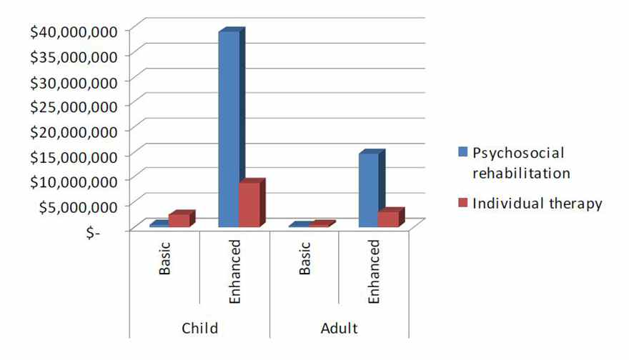
Before Optum Idaho

Slide 13
Case example: Oppositional Defiant Disorder (ODD)
Standard of care (e.g. AACAP) describes primary treatment as parenting skills training and family therapy, especially for younger Members
Assess for family use of coercion instead of modulated reinforcers
In older Members with intact cognitive capacity, problem-solving skills training has been shown effective with Family Therapy

Slide 14
ODD - 2
Use of individual modeling, shaping, emotion management skills training, coping skills training in ODD has not been shown effective
Trying to change the child but leaving family issues unaddressed is arguably unfair to the child, unproductive, and possibly counterproductive
Focusing on the child’s pathology enables family dysfunction
Medication therapy can be useful for co-occurring disorders (e.g. ADHD or depression) but not for ODD per se

Slide 15
CBRS issues – A Role in ODD Treatment?
Optum Coverage Determination Guidelines: Psychiatric rehabilitation medically necessary only for schizophrenia
Outside schizophrenia: Efficacy of CBRS poorly documented
Use in Bipolar Disorder, Major Depression promising
Pediatric conditions: Slight benefit for autism
Treatment non-responders: CBRS might extend or complement individual/family therapy
When office-based visits are hard to achieve or in-vivo work needed: Home-based monitoring and intervention under direction of family therapist
But family therapist can do home-based visits

Slide 16
CBRS: National Medical Necessity
For adults with severe mental illness with or without substance abuse
Includes living skills, social skills training, illness self-management, or supported employment to improve role functioning, not symptoms
Can be in group or individual setting
Goal: Member’s desire to reduce disability and improve functioning drives functional skills improvement (Recovery and Resiliency). Builds on strengths.
As Recovery progresses, needs change, sometimes requiring more intensive services, sometimes less
Instead of receiving a service daily for years, each person should receive what they need to live the lives they want to live in their communities

Slide 17
Next steps to best use the new benefit
Get the diagnosis right: psychiatric or doctoral-level psychological consultation if diagnosis does not fit, especially for high-risk cases
Know evidence-based practice (start with sections on
Optum idaho’s provider page)
Level of care guidelines
Coverage determination guidelines
Best practices
If delivering CBRS, read text books on psychiatric rehabilitation
e.g. Corrigan et al, principles and practice of psychiatric rehabilitation: an empirical approach, others
Count and track measurable primary outcomes
Deliver needed services using the expanded psychotherapy benefit

Slide 18
Using the benefit for maximum client value
Vignette:
38 y/o woman, major depressive disorder, hides under bed covers due to odd thought that she will have auditory hallucinations if she gets up even though she never has.
She will not be able see her prescriber for two more weeks. She usually does not come in to see her outpatient therapist.
She has a master’s level CBRS worker who comes to her home and works with her to challenge her beliefs about the dangers of getting out of bed; eventually she does get up and is able to do some chores around the house.
The CBRS worker is not doing psychosocial rehabilitation. She is doing CBT, challenging the validity of incorrect beliefs that hamper the woman. This is active treatment.
Preferably, under the Optum Idaho benefit, a licensed psychotherapist can conduct home-based visits using the individual psychotherapy benefit and code, going to the home 2-3 or more times weekly as needed to work on mobilizing the Member, using evidence-based CBT.

Slide 19
Using the benefit – part 2
6 year old with ODD is seeing a CBRS worker who is trying to model cooperative behavior and help the child cope with angry, frustrated parents
Preferably, a child psychiatrist or child psychologist will assess the child to rule out issues of autistic disorder, ADHD, and depression as well as other possible comorbid disorders
Under Optum Idaho, the parents can and should receive Family Therapy both with and without the presence of the child and incorporate Parenting Skills Training in Family Therapy
Under Optum Idaho, if office-based Family Therapy is not sufficient or if additional clinical assessment is deemed necessary to understand the dynamics at home, home-based parenting skills training and FT can be performed and billed for using the Family Therapy codes. The therapist should document in the record the reasons for using home-based rather than office-based therapy
Need for a CBRS worker in this setting is unclear

Slide 20
System Transformation
Develop member-centered care system based on Recovery and Resiliency principles
Improve outcomes by making best use of skills of licensed providers
Comprehensive service agencies to provide easy access to the full spectrum of needed services
Notes:
Reasons for comprehensive service agencies:
Encourages multimodality treatments
Continuity of care across providers
Integration of clinical information about treatment
Removes barriers to communication among providers
Increases opportunities to provide members medically necessary treatment

Slide 21
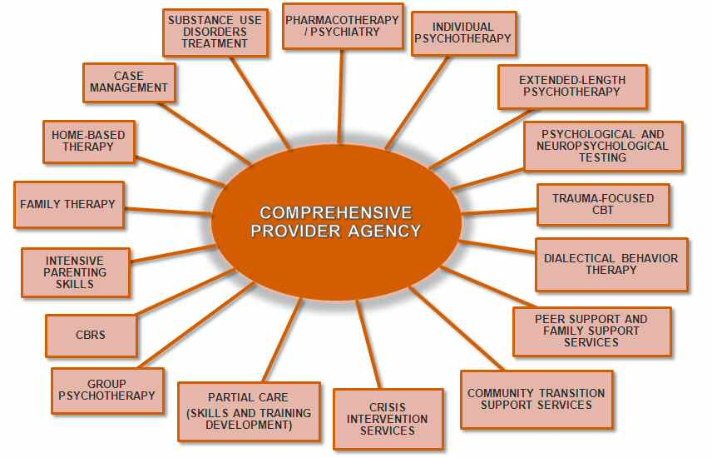
What We Want to See: One Stop

Slide 22
Transformation
This will take time
Optum Idaho is aware that setting up new service plans that enrich care sometimes requires transitional services
There are exciting new possibilities for constructing more incisive and effective treatment plans
There will always be a need for CBRS. As with all services, in the future we look to it being used with precision and within the scope of its practice

Slide 23
Summary
Improve care outcomes by using broader spectrum of services covered by Optum Idaho
Start by offering what is known to work
Let’s join efforts and partner to improve the behavioral health of Idaho’s citizens.
Together, we can do better!

Slide 24
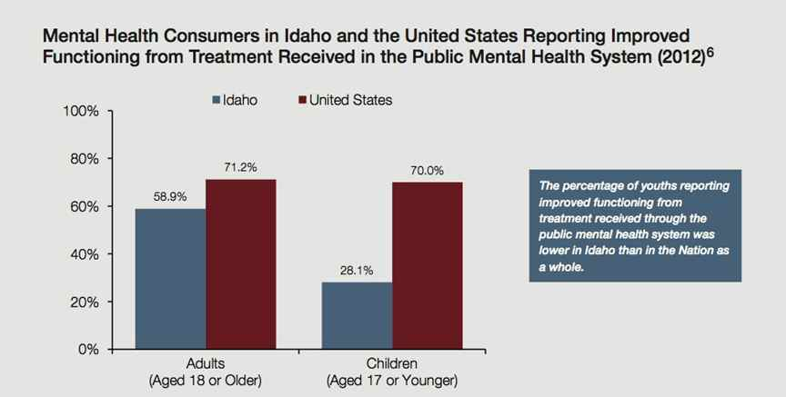
SAMHSA Study 2012 – Idaho vs. the Nation

